Slide 1
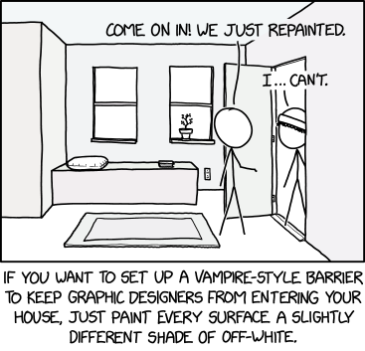
User interfaces
xkcd

Slide 2
UI: Week 4
Dr. Jillian Aurisano
Plan for today:
Announcements/Course logistics
Color
Activity
Notes:
So welcome to engineering visual interfaces for data science. I'm Dr Aurisano.
Thanks for finding the class on Zoom. Hopefully we will be in person again soon.
If anyone out there is comfortable turning on their cameras, that is lovely- then I feel like I am talking to students, rather than to myself.
Here’s our plan for today:
First I’m going to introduce myself, so you know a bit about me
Then we are going to get to know each other, in Zoom breakout rooms. This will give us a chance to make sure that Zoom breakout rooms work, and we all know how to access them.
Then, I am going to walk through the structure, and plan for the course. I want to make sure everyone knows how the course will work, and what to expect, and also a bit about why the course is designed this way.
Then I am going to introduce the class, and what the class is about. Since this is a new class, and one of just a few classes in human centered computing here at UC, I wanted to give an overview of the topic.
Then I have an introductory activity, which we will do in breakout rooms, and which I think will help motivate the discussion on Wednesday, and getting into the meat of the class.

Slide 3
Project 1- a few changes
I am making a small change to the deadlines, giving a bit of extra time
Monday 9/23 11:59pm Code due
Tuesday 9/24 11:59pm Documentation due
Wednesday in class- presentations (see note to follow)
Changes in presentation format- small group discussions on Wednesday 9/25
Added an extra day for the publicly hosted code
Why
I looked over the whole schedule for the semester and think it will work
All projects will be due code- Monday, doc- Tuesday
(with the possible exception of P4)
Prefer having things due on weekdays, not weekends
Gives folks time to get help with issues on Monday
Don’t expect extra time for future projects- this is going to be it

Slide 4
Project 1 clarifications
No need to save user entries outside of the session
This is not needed for the first project
Goal: Getting up to speed with web dev, Svelte. Visual and interaction design for a prototype. What you are showing is a demo of your design.
I suggest setting this up for an imagined user who has a few previous entries, and some existing settings
No need for a login or onboarding experience
Can add a ‘frame’ or info button to your site, to explain that this is a prototype and a demo of an envisioned system, and link to your documentation

Slide 5
Project 1
Design brainstorming- 10-plus-10
Some confusion….
Upload your sketches or link to them in some way in your documentation.
Embed images, image carousel, ….

Slide 6
This week’s (and next weeks) assignment
Find project 2 groups: 3-4 people
Work on your project

Slide 7
Let’s talk about color!!

Slide 8
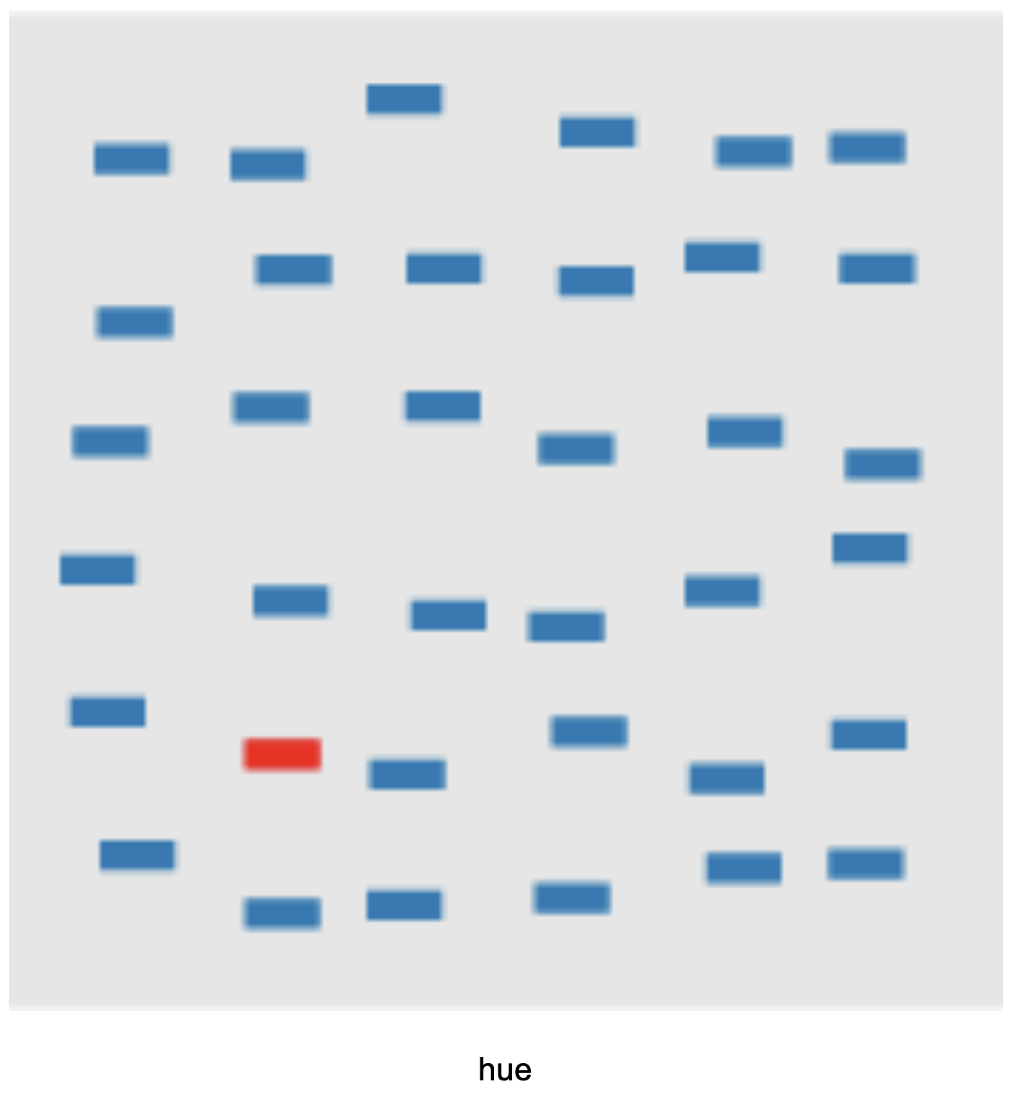
Color and Effective UI
Effective UIs communicate their usage to users
We are communicating primarily through visual channels
Color is a strong visual channel – let’s think about how to use it
Example here- target detection
How fast do we see the target, when encoded with a difference in color hue?

Slide 9
Color is a strong visual chanel
Example here- target detection
How fast do we see the target, when encoded with a difference in color hue?

Slide 10
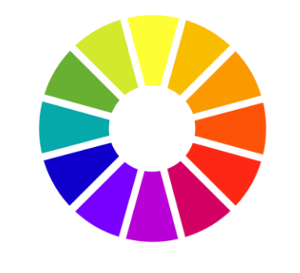
How can we think about color?
Color wheel
Let’s look at 3 dimensions of color:
Hue
Saturation
Value

Slide 11
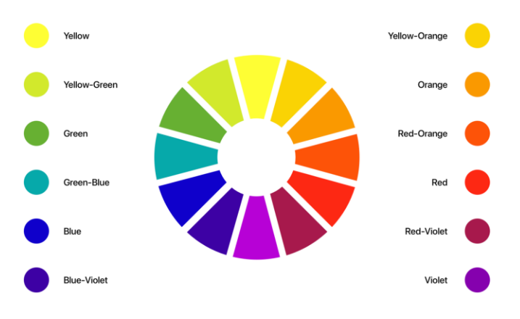
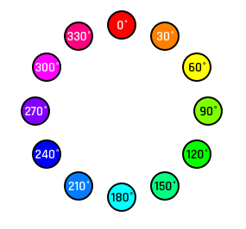
Hue
Probably the first thing we think of
What color is it? Blue
Can be defined on a scale from 0 to 360
https://uxdesign.cc/all-you-need-to-know-about-colors-in-ui-design-theory-practice-235179712522

Slide 12
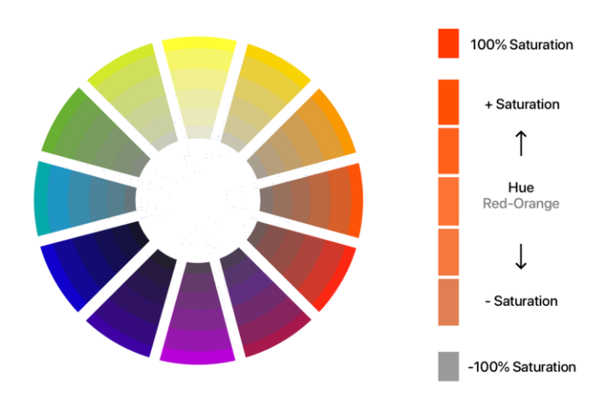
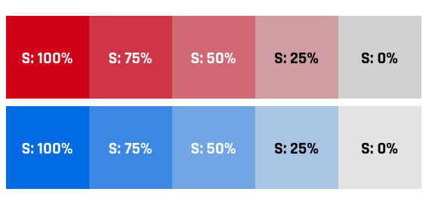
Saturation
Intensity of the color
Richness of the color
100% saturation: bright color
0% saturation:
dull color
Range from white, grey to black, depending on the value
Defined on a scale 0 to 100
https://uxdesign.cc/all-you-need-to-know-about-colors-in-ui-design-theory-practice-235179712522

Slide 13
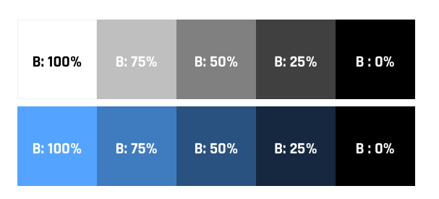
Value
Value is the amount of light and darkness color has
How bright the color is
Value 100%: bright color
Value 0%: black
In between: light->dark shades of a hue
https://uxdesign.cc/all-you-need-to-know-about-colors-in-ui-design-theory-practice-235179712522

Slide 14
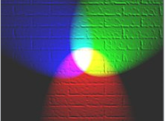
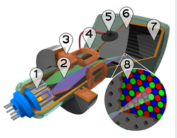
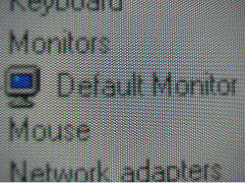
Alternate color model: RGB (Red, Green, Blue)
RGB
Red value (0-255, or 0.0-1.0)
Green value (0-255, or 0.0-1.0)
Blue value (0-255, or 0.0-1.0)
Light , how displays work
RGB is additive
Light spectra add together to produce the color
Displays use RGB in how they present color to users
Closely positioned red, green and blue light sources - > pixel color at that spot

Slide 15

There is also a hexidecial representation of the RGB colors
Don’t have to type as many numbers…

Slide 16
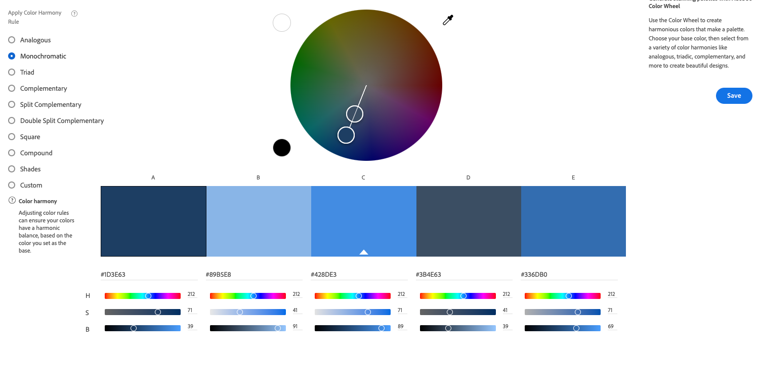
Let’s play with this….
Adobe color
https://color.adobe.com/create/color-wheel

Slide 17
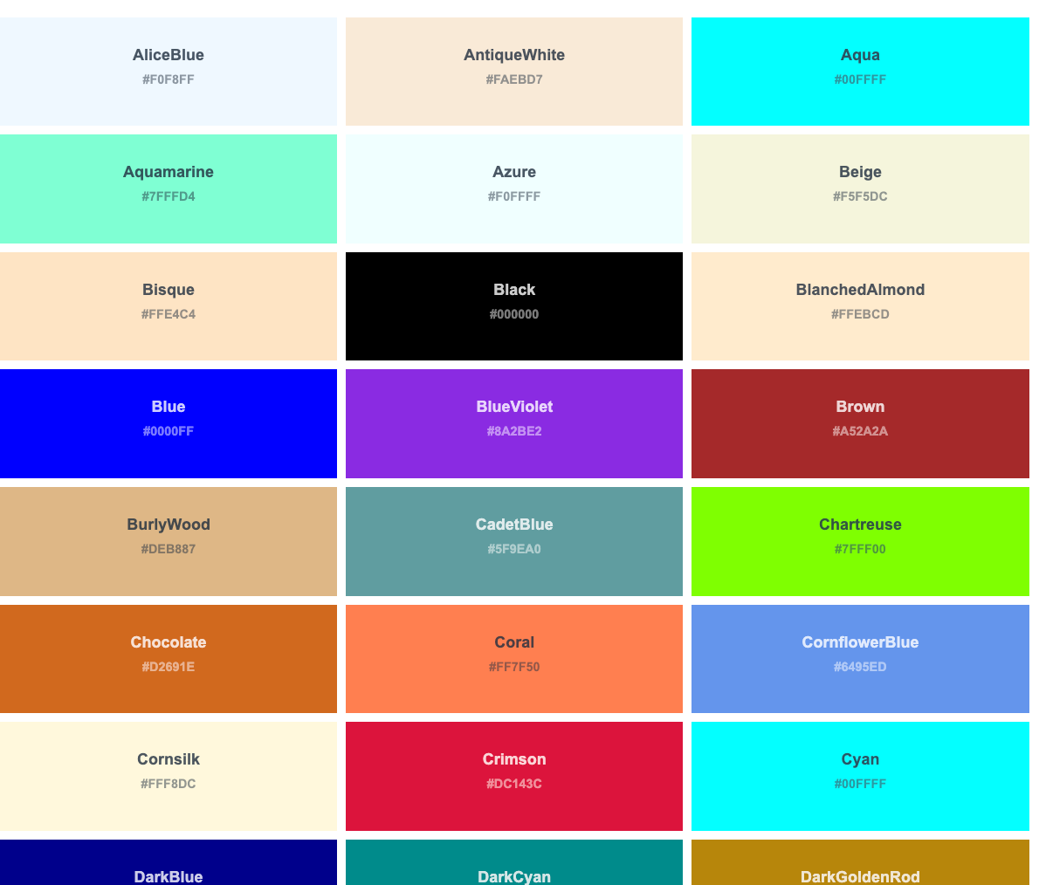
Or can use color names
https://www.w3schools.com/tags/ref_colornames.asp

Slide 18
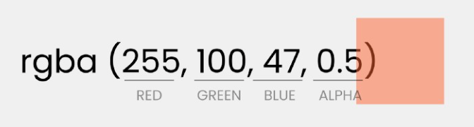
Alpha: transparency
RGBA

Slide 19
Color websites
https://htmlcolorcodes.com/
https://material.io/design/color/the-color-system.html#tools-for-picking-colors
https://www.colourlovers.com/palettes/add
https://coolors.co/
http://paletton.com/#uid=1000u0kllllaFw0g0qFqFg0w0aF

Slide 20
How do we use color?
You are probably making decisions about color for project 1
What are some principles?

Slide 21
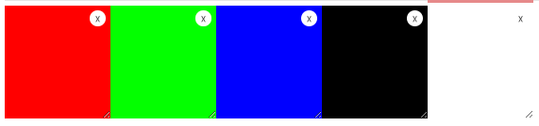
A few basics
In general, DON’T use straight Red 100%, Blue 0%, Green 0% colors

Slide 22
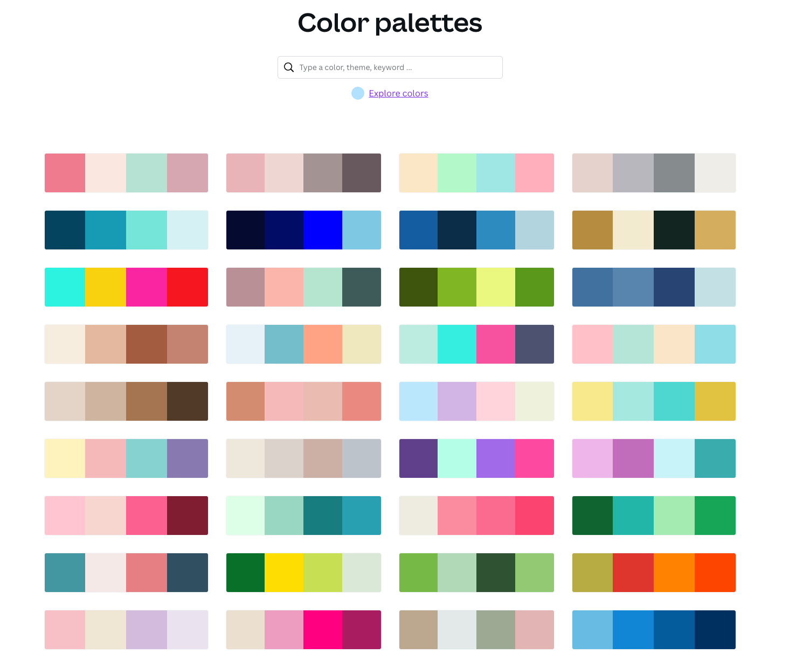
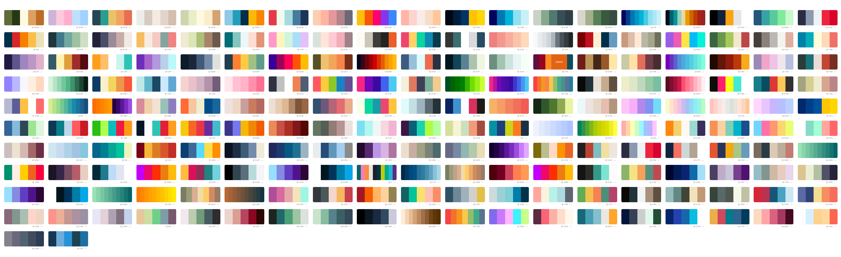
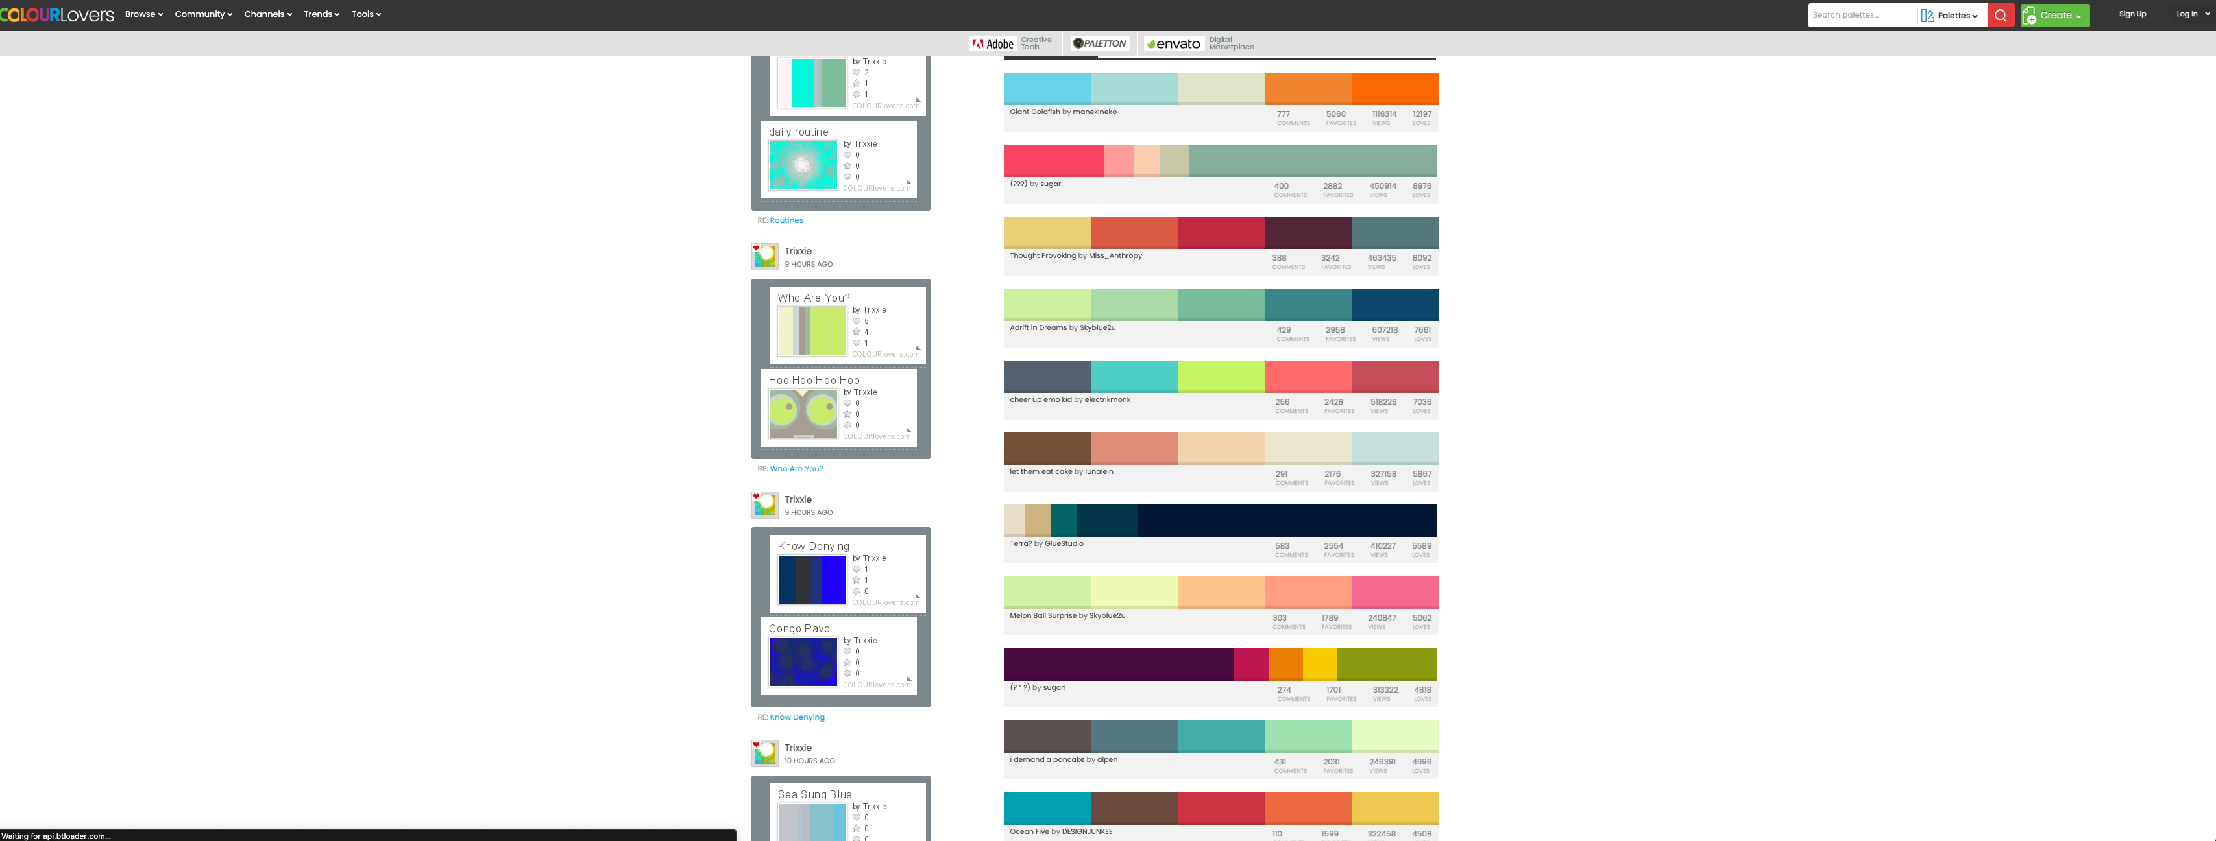
If you are unsure: use resources
Canva.com
Coolors.co
Color.adobe
ColourLover.com
List here:
https://htmlburger.com/blog/ui-color-scheme/

Slide 23
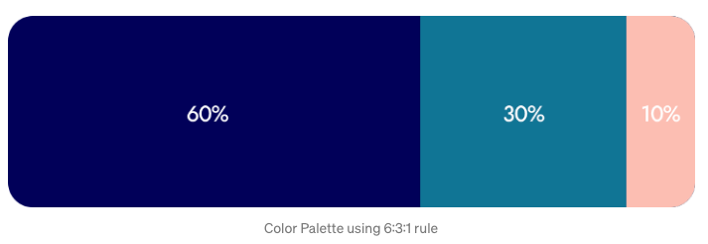
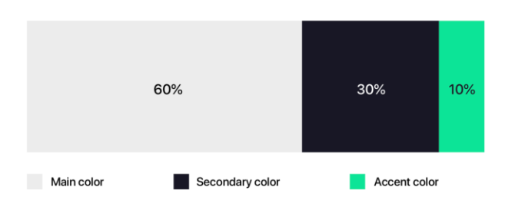
Rule of 60 – 30 – 10
“Golden ratio”
Main color: 60%
Secondary color: 30%
Accent color: 10%
Can help you avoid having too many colors

Slide 24
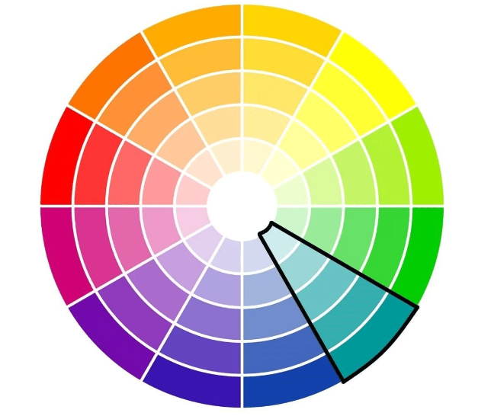
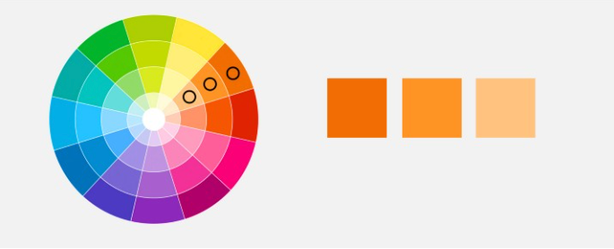
Monochromatic color schemes
Pick a color, choose variations on that color (modify saturation or value)
”sophisticated”
”subtle”
https://www.oberlo.com/blog/color-combinations-cheat-sheet
https://uxplanet.org/ultimate-guide-to-color-in-ux-ui-design-de8eb104b5d3

Slide 25
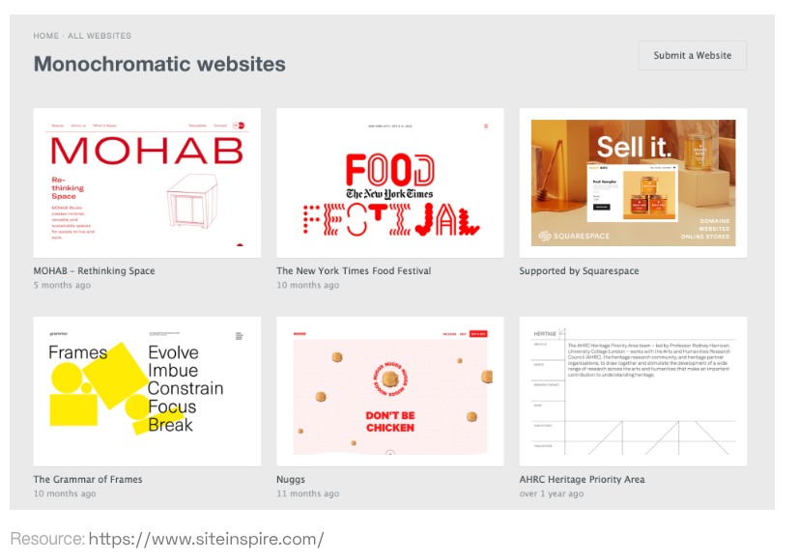
Monochromatic

Slide 26
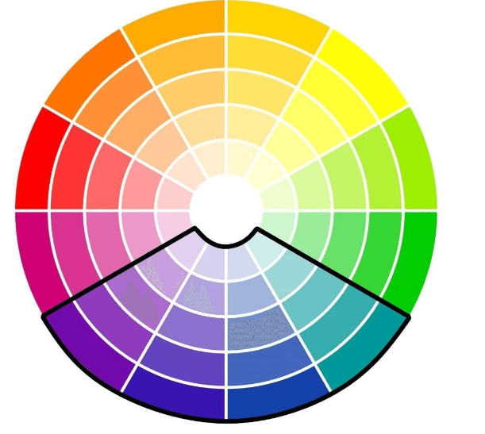
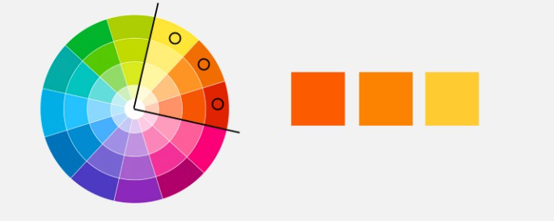
Analogous color schemes
Hues next to each other on color wheel
”dynamic”
https://www.oberlo.com/blog/color-combinations-cheat-sheet
https://uxplanet.org/ultimate-guide-to-color-in-ux-ui-design-de8eb104b5d3

Slide 27
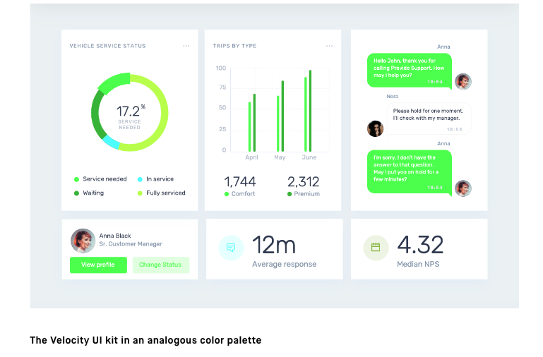
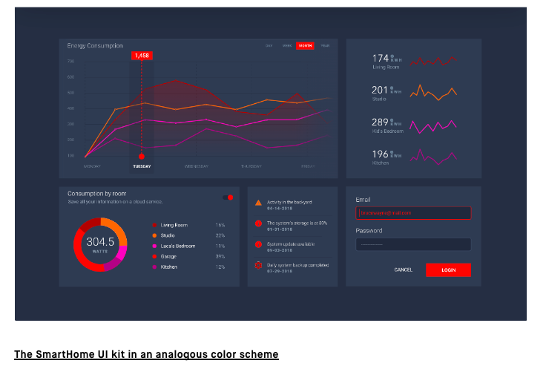
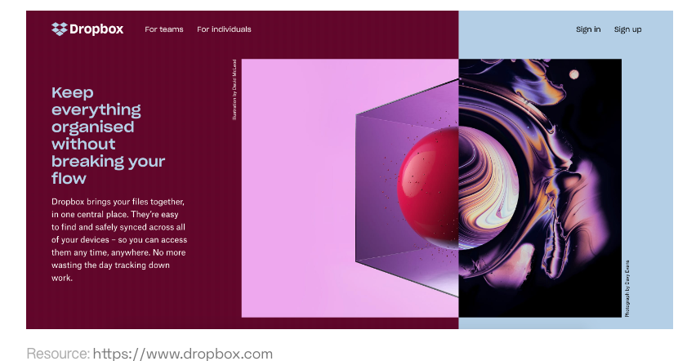
Analogous color schemes
https://www.invisionapp.com/inside-design/analogous-colors/

Slide 28
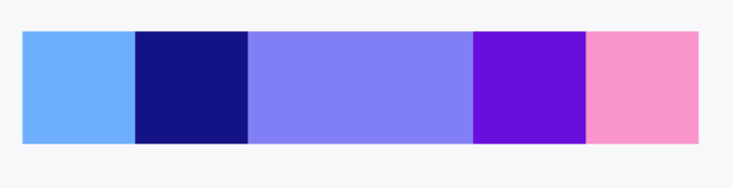
Analogous color schemes
Add variety with shifts in saturation and brightness

Slide 29
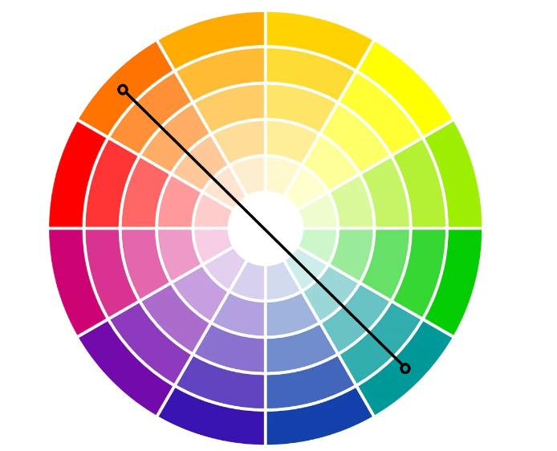
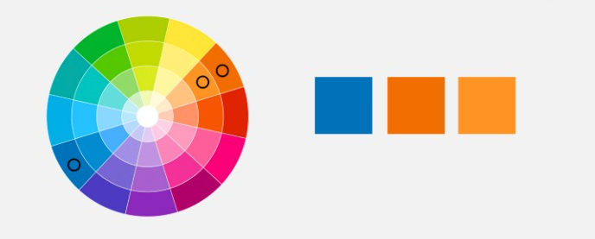
Complementary
Across the color wheel:
Base color: blue
Complementary color: orange
Optional Add a monochromatic color: light orange
“Vibrant”
Interplay of cool and warm colors
https://www.oberlo.com/blog/color-combinations-cheat-sheet
https://uxplanet.org/ultimate-guide-to-color-in-ux-ui-design-de8eb104b5d3

Slide 30

Complementary

Slide 31
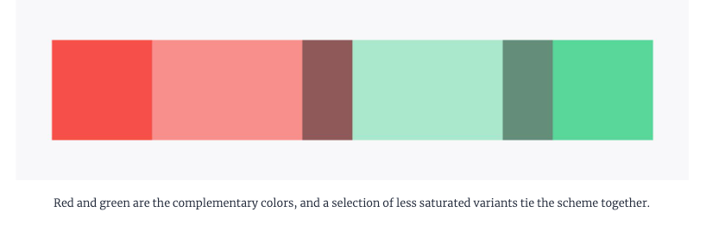
Complementary
Adding variation in saturation and value

Slide 32

But be careful….
Complementary colors of the exact same saturation and value
“pulsing effect”
Can be uncomfortable

Slide 33
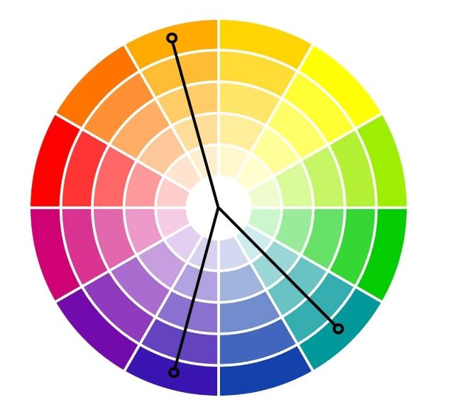
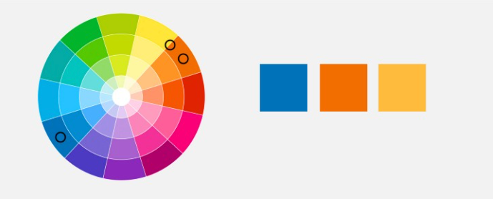
Split complementary
Across the color wheel
Base color: blue
Choose 2 colors across the color wheel, slightly split/offset
https://www.oberlo.com/blog/color-combinations-cheat-sheet
https://uxplanet.org/ultimate-guide-to-color-in-ux-ui-design-de8eb104b5d3

Slide 34
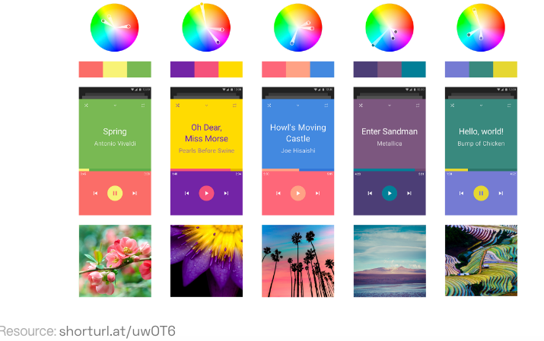
Split complementary

Slide 35
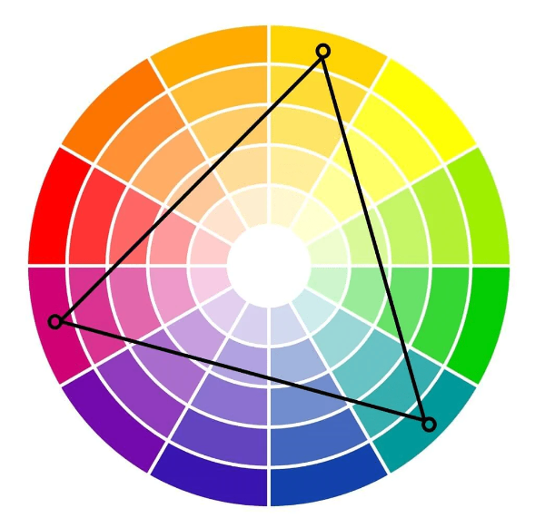
Triadic
Choose colors in triangle configuration
Red, Yellow, Blue
Purple, green, orange
Playful, youthful
Could be overwhelming
https://www.oberlo.com/blog/color-combinations-cheat-sheet

Slide 36
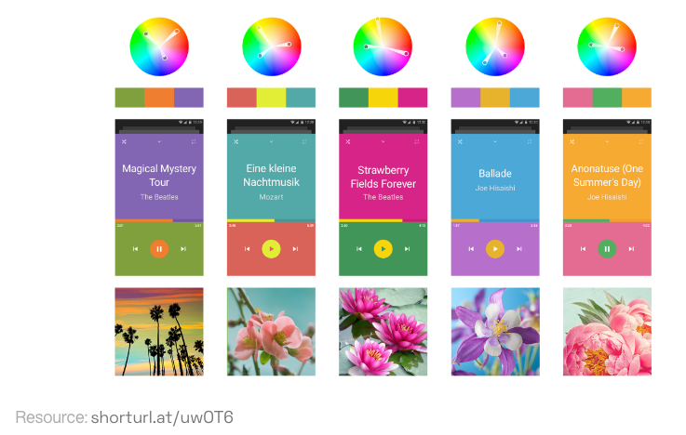
Triadic

Slide 37
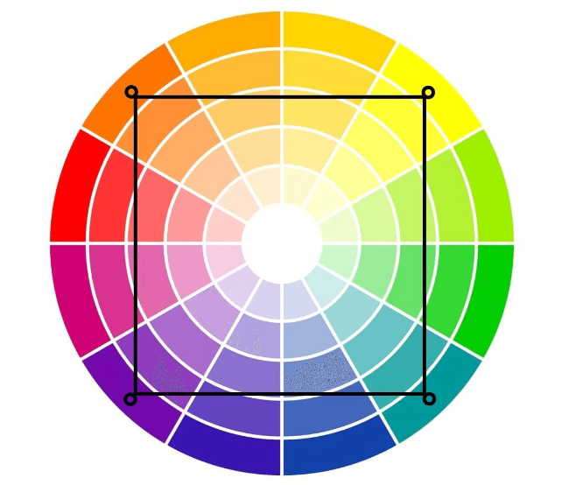
Tetradic color schemes
Colors are equidistant
Pick 4
Loud, fun, vibrant
But potentially overwhelming
https://www.oberlo.com/blog/color-combinations-cheat-sheet

Slide 38
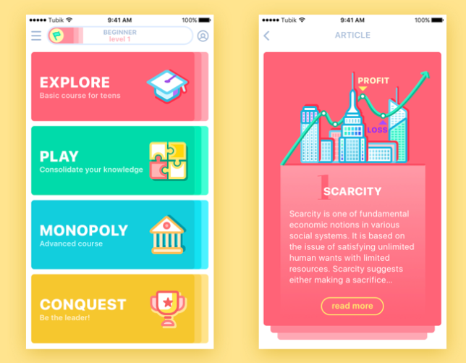
Tetradic
https://www.qed42.com/insights/coe/design/understanding-colors-ui-design

Slide 39

Blue
Blue
Cool color
Trust, credibility
Most common favorite color

Slide 40
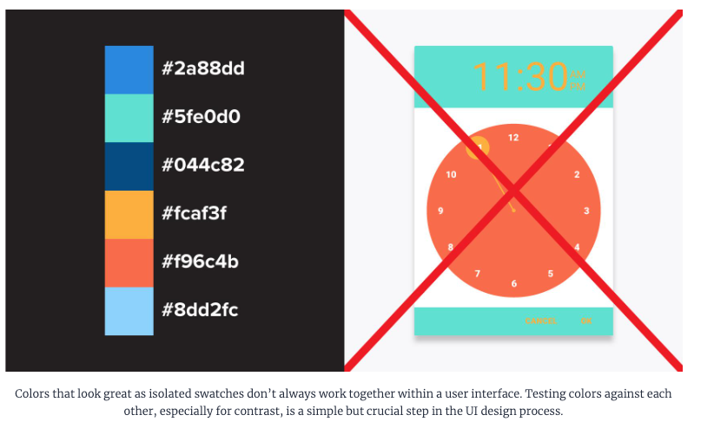
Note:
https://www.toptal.com/designers/ui/ui-color-guide

Slide 41
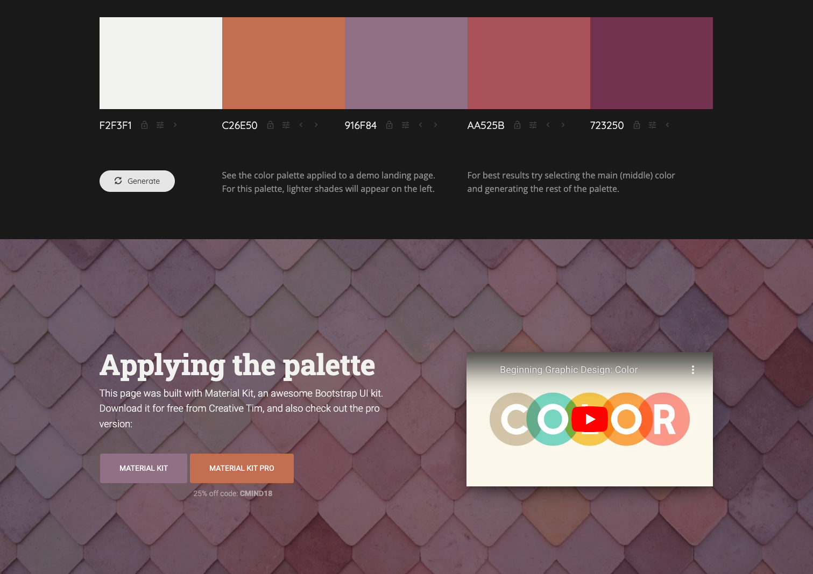
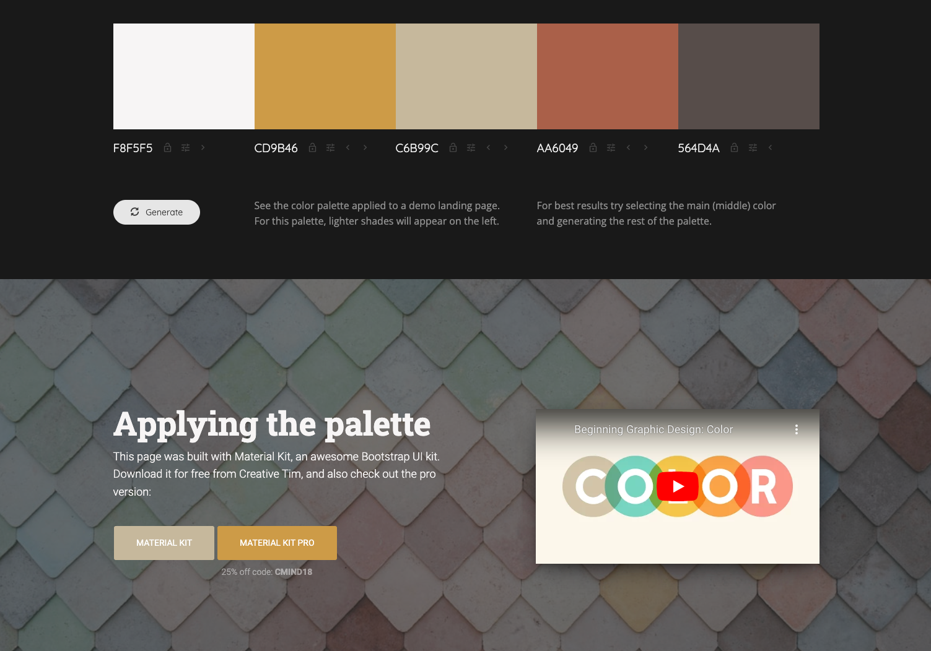
How will this look in practice
Nice resource: http://colormind.io/bootstrap/

Slide 42
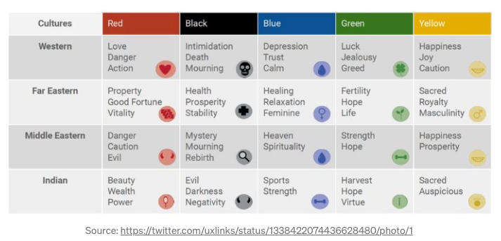
Colors associations are cultural Color associations change over time
Lots of the rules we find out there are tailored to European/American audiences

Slide 43
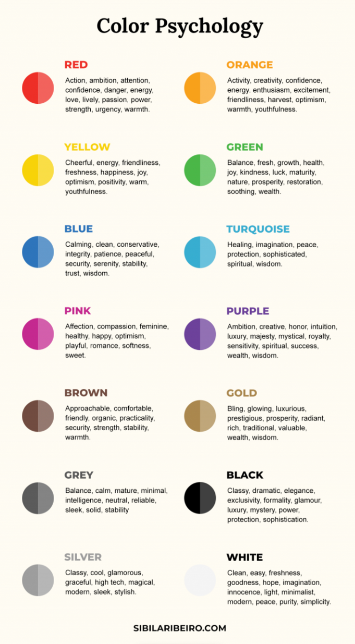
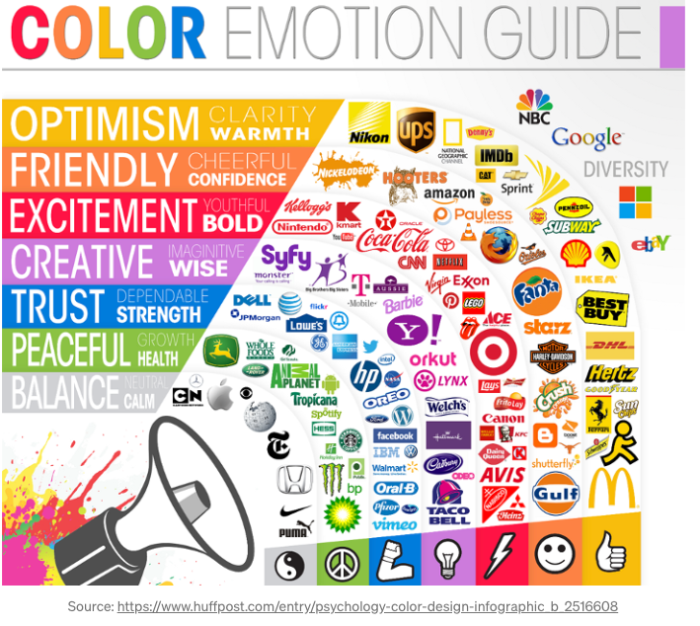
Some color psychology….

Slide 44
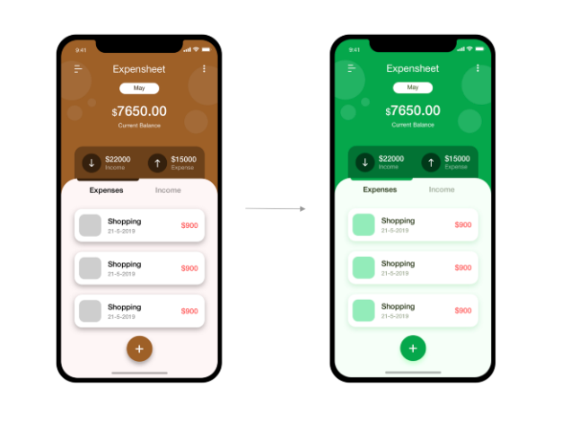
Color matters
https://medium.com/iconscout/colors-in-ui-design-theory-psychology-practice-f6d6a5e6e04d

Slide 45
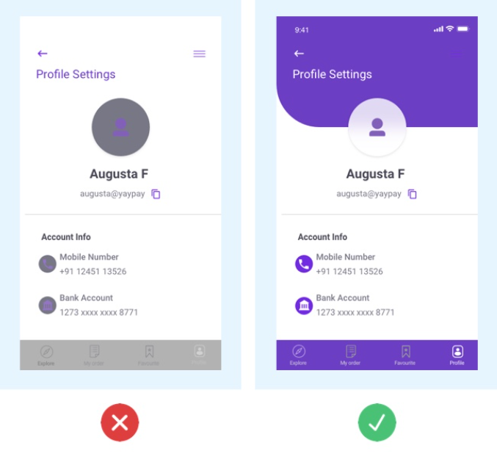
Contrast
Contrast in a UI is used to draw attention
If you have low contrast between visual elements, they may all blur together
How to use contrast:
Draw attention: high contrast for calls for action
Separate sections: use contrast to partition elements
Background/foreground: use contrast to bring elements to the foreground

Slide 46
Contrast is also important for accessibility
Viewing in varied lighting conditions
People with vision impairments
People with color blindness

Slide 47
Color blindness
Color blindness is more common than you may think (8% of men and .5% of women)
There are several forms of color blindness
Most common: Red, green color blindness
Let’s see how we all do…
(sometimes someone discovers they are color blind in class =O )
Do you see these numbers?

Slide 48
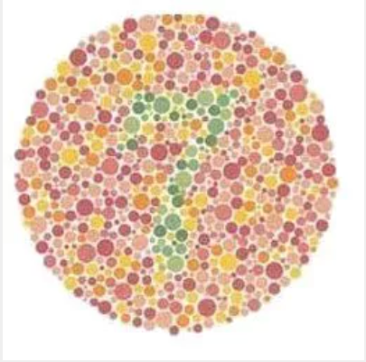

Slide 49
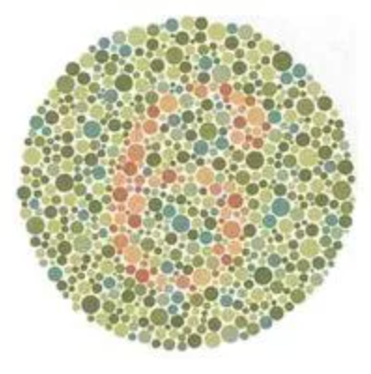

Slide 50
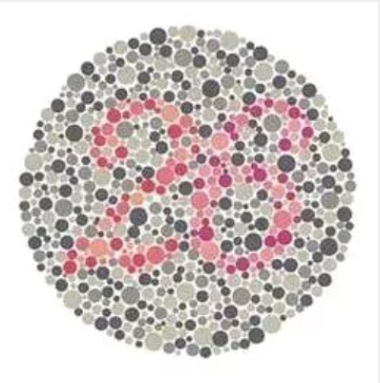

Slide 51


Slide 52


Slide 53


Slide 54


Slide 55


Slide 56


Slide 57


Slide 58


Slide 59


Slide 60

Check for color blindness
http://www.color-blindness.com/coblis-color-blindness-simulator

Slide 61

Color blindness and color wheel

Slide 62

Color blindness and UI
If you only use color to indicate if something is selected, depending on the color, a color blind user may not be able to tell it is selected
https://www.toptal.com/designers/ui/ui-color-guide

Slide 63

Color blindness and UI
Use text, icons with color
Don’t rely on color alone

Slide 64

Checking accessibility
WebAIM
noCoffee
Accessibility scanner

Slide 65
Let’s explore color

